Slide 1


Predicting Auto Insurance Risk Using Gradient Boosting
Analyzing Socio-Economic Factors in Car Crashes for New York City
Author: AJ Strauman-Scott
City University of New York Master’s Capstone Project
July 2025
Notes:
Welcome, and thank you for joining me today. My presentation focuses on predicting auto insurance risk using advanced machine learning techniques, specifically gradient boosting with XGBoost.
The goal of this project is to explore how socio-economic data, combined with open crash data from New York City, can be used to build interpretable models that reveal the neighborhood-level factors driving crash risk. By treating crash frequency as a proxy for insurance claim frequency, we aim to uncover patterns that are both useful for insurers and relevant to urban traffic safety planning.
Throughout this presentation, I’ll walk you through the motivation for the study, the data sources we used, the modeling process, and the results we obtained. I’ll also highlight the most predictive variables identified by SHAP explainability and discuss what these findings mean for both insurance risk modeling and public policy.
Let’s start with some background on the challenges of traditional risk modeling and why machine learning offers a better solution for this problem.

Slide 2

Background
Accurate insurance risk modeling is essential for fair premiums and portfolio management.
NYC's traffic risks are shaped by socio-economic factors, dense infrastructure, and urban scaling dynamics.
Traditional actuarial models (GLMs) struggle with non-linear and complex interactions.
Gradient Boosting Models (GBMs), especially XGBoost, can outperform GLMs for crash/claim prediction.
SHAP explainability bridges the gap between model accuracy and interpretability.
Few studies combine socio-economic and crash data for auto insurance risk modeling — this study fills that gap.
Notes:
In this slide, I highlight the background and context of the study. Accurate risk modeling is critical for insurers to set fair premiums and manage portfolios effectively. New York City, with its complex mix of socio-economic disparities and dense urban infrastructure, presents unique challenges for traffic risk analysis. By leveraging open data, specifically NYC Motor Vehicle Collisions and ACS socio-economic indicators, we can develop robust proxy models for claims prediction.
Traditional actuarial approaches like GLMs, while interpretable, lack the ability to model non-linearities and complex feature interactions. Recent studies have demonstrated that Gradient Boosting Models, such as XGBoost, are superior in capturing these complexities. However, one of the challenges with such models is explainability — this is where SHAP provides value, offering clear insights into which variables drive model predictions. Our study addresses a key research gap by integrating socio-economic and crash data to understand neighborhood-level predictors of auto insurance risk.

Slide 3

Research Questions
Which socio-economic, transportation, and demographic factors are most predictive of crash risk?
What quantity of risk can be predicted solely by these factors using a XGBoost model?

Slide 4
Data and Sources
ACS 5-year estimates (2018–2023)
Variables: Demographics, income, median gross rent, education, employment, transportation.
Engineered features: Poverty × vehicle ownership, unemployment × vehicle ownership.
NYC Motor Vehicle Collisions (MVC) Open Data Portal
Aggregated to 2020 Census Tracts.
Normalized as crashes per 1,000 residents (proxy for claim frequency).
PREPROCESSING:
Data cleaning: Removal of invalid coordinates, spatial join with 2020 census tracts.
Harmonization of ACS variables, binning, and removal of highly correlated features.
Log transformation of crash counts to reduce variance.
Notes:
This slide outlines the data sources and key metrics driving our analysis. We leverage NYC Motor Vehicle Collisions (MVC) data from 2018 to 2023, aggregated at the census tract level, capturing variables such as crash counts, injuries, fatalities, vehicle types, and contributing factors. By normalizing this data to crashes per 1,000 residents, we create a consistent risk metric comparable across neighborhoods.
To complement the crash data, we incorporate socio-economic variables from the ACS 5-year estimates. These include demographic characteristics, income, housing costs, education, employment rates, and transportation behaviors. We also engineered interaction features, like the combination of poverty and vehicle ownership, which we hypothesized would amplify crash risks.
Preprocessing involved cleaning the MVC data, removing invalid geolocations, and harmonizing ACS variables to 2020 census boundaries. We removed redundant variables that were too highly correlated, ensuring the model remained efficient and interpretable. Finally, we log-transformed the crash counts to stabilize variance and minimize the impact of outliers, which is especially helpful when modeling skewed crash data.

Slide 5
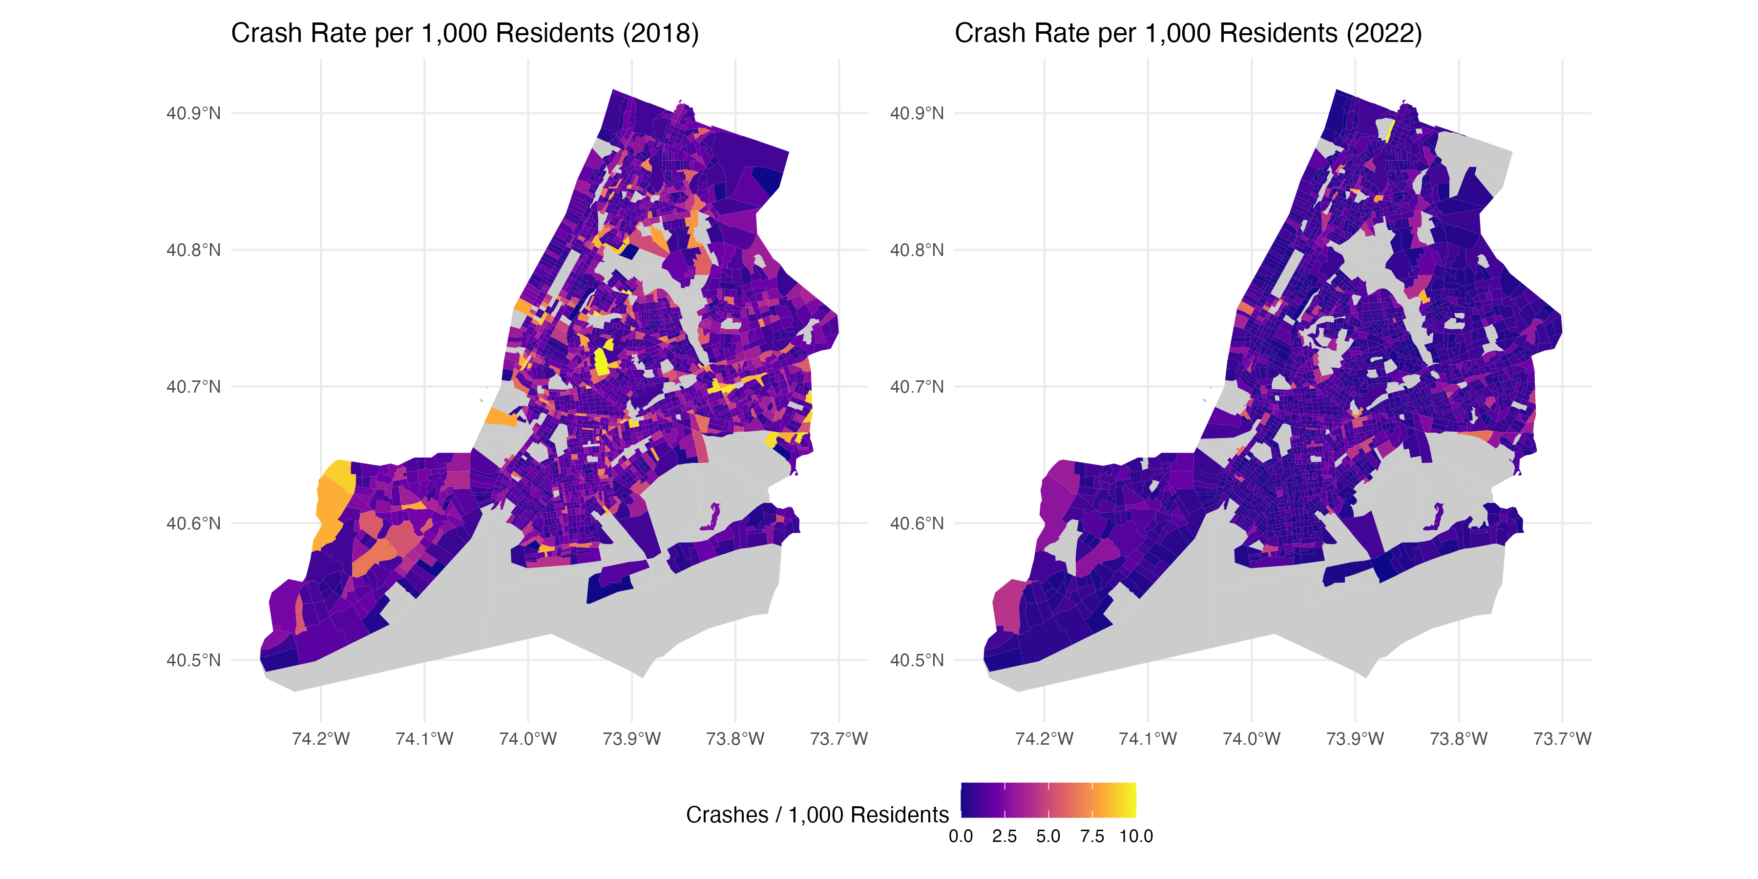
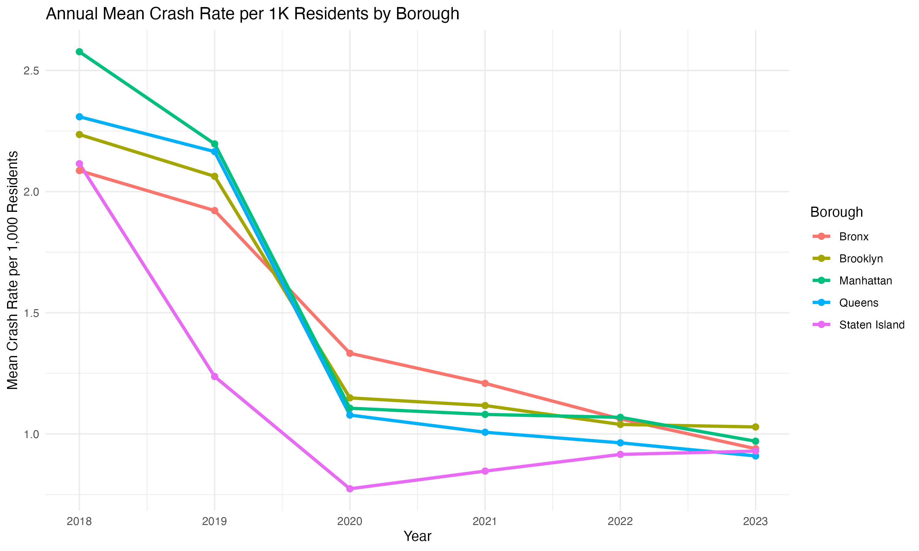
Descriptive Statistics
Average crash rate: 1.43 crashes/1,000 residents (max > 23/1,000)
Crash rates declined during the pandemic (2020) with gradual rebound.
Hotspots: South Bronx, central Brooklyn, northern Manhattan.
Median household income: $74,681
Median gross rent: $1,589
Notes:
This slide presents the descriptive statistics from our dataset of 13,518 census tract–year observations The line chart on the left shows the crash rate trends by borough over time. We can see a clear decline in crash rates during 2020, which aligns with the COVID-19 pandemic and associated traffic reductions. Following 2020, the rates stabilized but remained below pre-pandemic levels. Bronx and Queens consistently record the highest crash rates per 1,000 residents, while Staten Island and Manhattan remain on the lower end.
The maps on the right compare crash rates between 2018 and 2022 at the census tract level. In 2018, we observe high crash intensities concentrated in central Brooklyn, the South Bronx, and northern Manhattan. By 2022, these hotspots remain but appear less severe, illustrating both a city-wide decline in crash rates and persistent high-risk corridors. Using a consistent color scale across the two maps highlights these reductions and the spatial clustering of risk.

Slide 6

Model Framework
Algorithm: XGBoost, chosen for non-linear modeling and strong predictive performance in insurance contexts.
SHAP values used to interpret variable contributions and interactions.
Optimization and Validation
Hyperparameter Tuning: Conducted via Optuna (Bayesian optimization) for optimal learning rate, tree depth, and regularization.
Cross-Validation: Spatial cross-validation by borough to prevent geographic overfitting.
Notes:
SHAP (SHapley Additive exPlanations) has become the state-of-the-art framework for interpreting complex ML models. Developed by \citet{lundberg}, SHAP is grounded in cooperative game theory, assigning each feature a Shapley value that quantifies its contribution to individual predictions. Unlike traditional feature importance metrics—such as Gini importance in random forests or split gain in XGBoost—SHAP accounts for both main effects and feature interactions, offering a consistent and additive explanation of how variables drive model outputs.
Our modeling approach leveraged XGBoost due to its proven ability to capture complex, non-linear relationships and variable interactions—key requirements when working with socio-economic and crash data. To ensure the model remained interpretable, we applied SHAP values to understand which features contributed most to predictions, allowing both global and local explanations.
We used Optuna, a Bayesian optimization framework, to systematically tune the model's hyperparameters, including the learning rate, maximum tree depth, and regularization terms. This automated process significantly improved accuracy compared to default settings.
To prevent geographic bias, we implemented spatial cross-validation, splitting the data by borough rather than randomly. This ensured that performance metrics reflected the model’s ability to generalize across distinct urban regions.

Slide 7
Results
• Model Metrics: R² = 0.26, RMSE = 1.55, MAE = 0.84.
• Top Predictors (via SHAP):
- Post-pandemic indicator.
- Median gross rent.
- Labor force participation (peak risk at 60–70%).
- Poverty × vehicle ownership interaction.

Slide 8
Insights
• Socio-economic drivers: income, rent, and commuting patterns strongly correlate with crash risk.
• Post-pandemic traffic changes increased crash severity.
• Equity issues: Higher crash risks in economically vulnerable communities.
• Application: Useful for neighborhood-level portfolio risk analysis, not individual underwriting.

Slide 9

Conclusions and Future Research
Gradient boosting reveals interpretable, socio-economic crash risk patterns.
Model limitations: Only explains ~26% variance; fairness concerns for underwriting.
Future Work:
Integrate telematics (real-time driving behavior) and other variables like weather.
Develop fairness-aware ML to reduce socio-economic bias.
Explore temporal modeling for seasonal and event-driven risk factors.

